Slide 1
Predicting customer buying behaviour
Build a predictive model to understand factors that influence buying behaviour

Slide 2
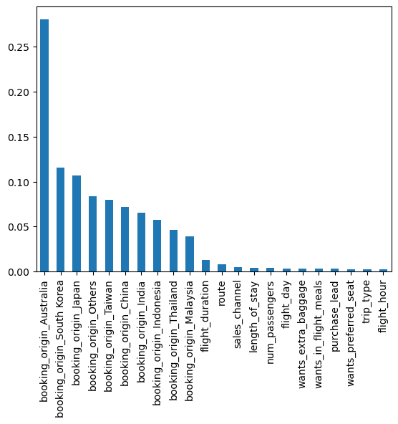
The variable contribute to the model booking origin of Australia is gave 28% of contribution to this model

Slide 3
